Slide 1
Output Devices
Chapter 6

Slide 2
Recorder
A recorder is a measuring instrument that displays a time-varying signal in a form easy to examine and re-examine, even after the original signal has ceased to exist.
Recording preserves the experimental data in a manageable and usable form.
Two types:
  Analog Recorder
  Digital Recorder

Slide 3
Recorder
Analog Recorder
Graphic Recorder Oscillographic Recorder Magnetic Tape Recorder
Strip Chart Recorder X-Y Recorder Circular Chart Recorder

Slide 4
Strip Chart Recorder
It records one or more variables with respect to time. It is a X-t recorder.
A strip chart recorder consists of:
  A long roll of graph paper moving vertically.
  A system for driving the paper at some selected speed.
  A stylus for making marks on the graph paper.
  A stylus driving system which moves the stylus in exact replica of quantity being measured.

Slide 5
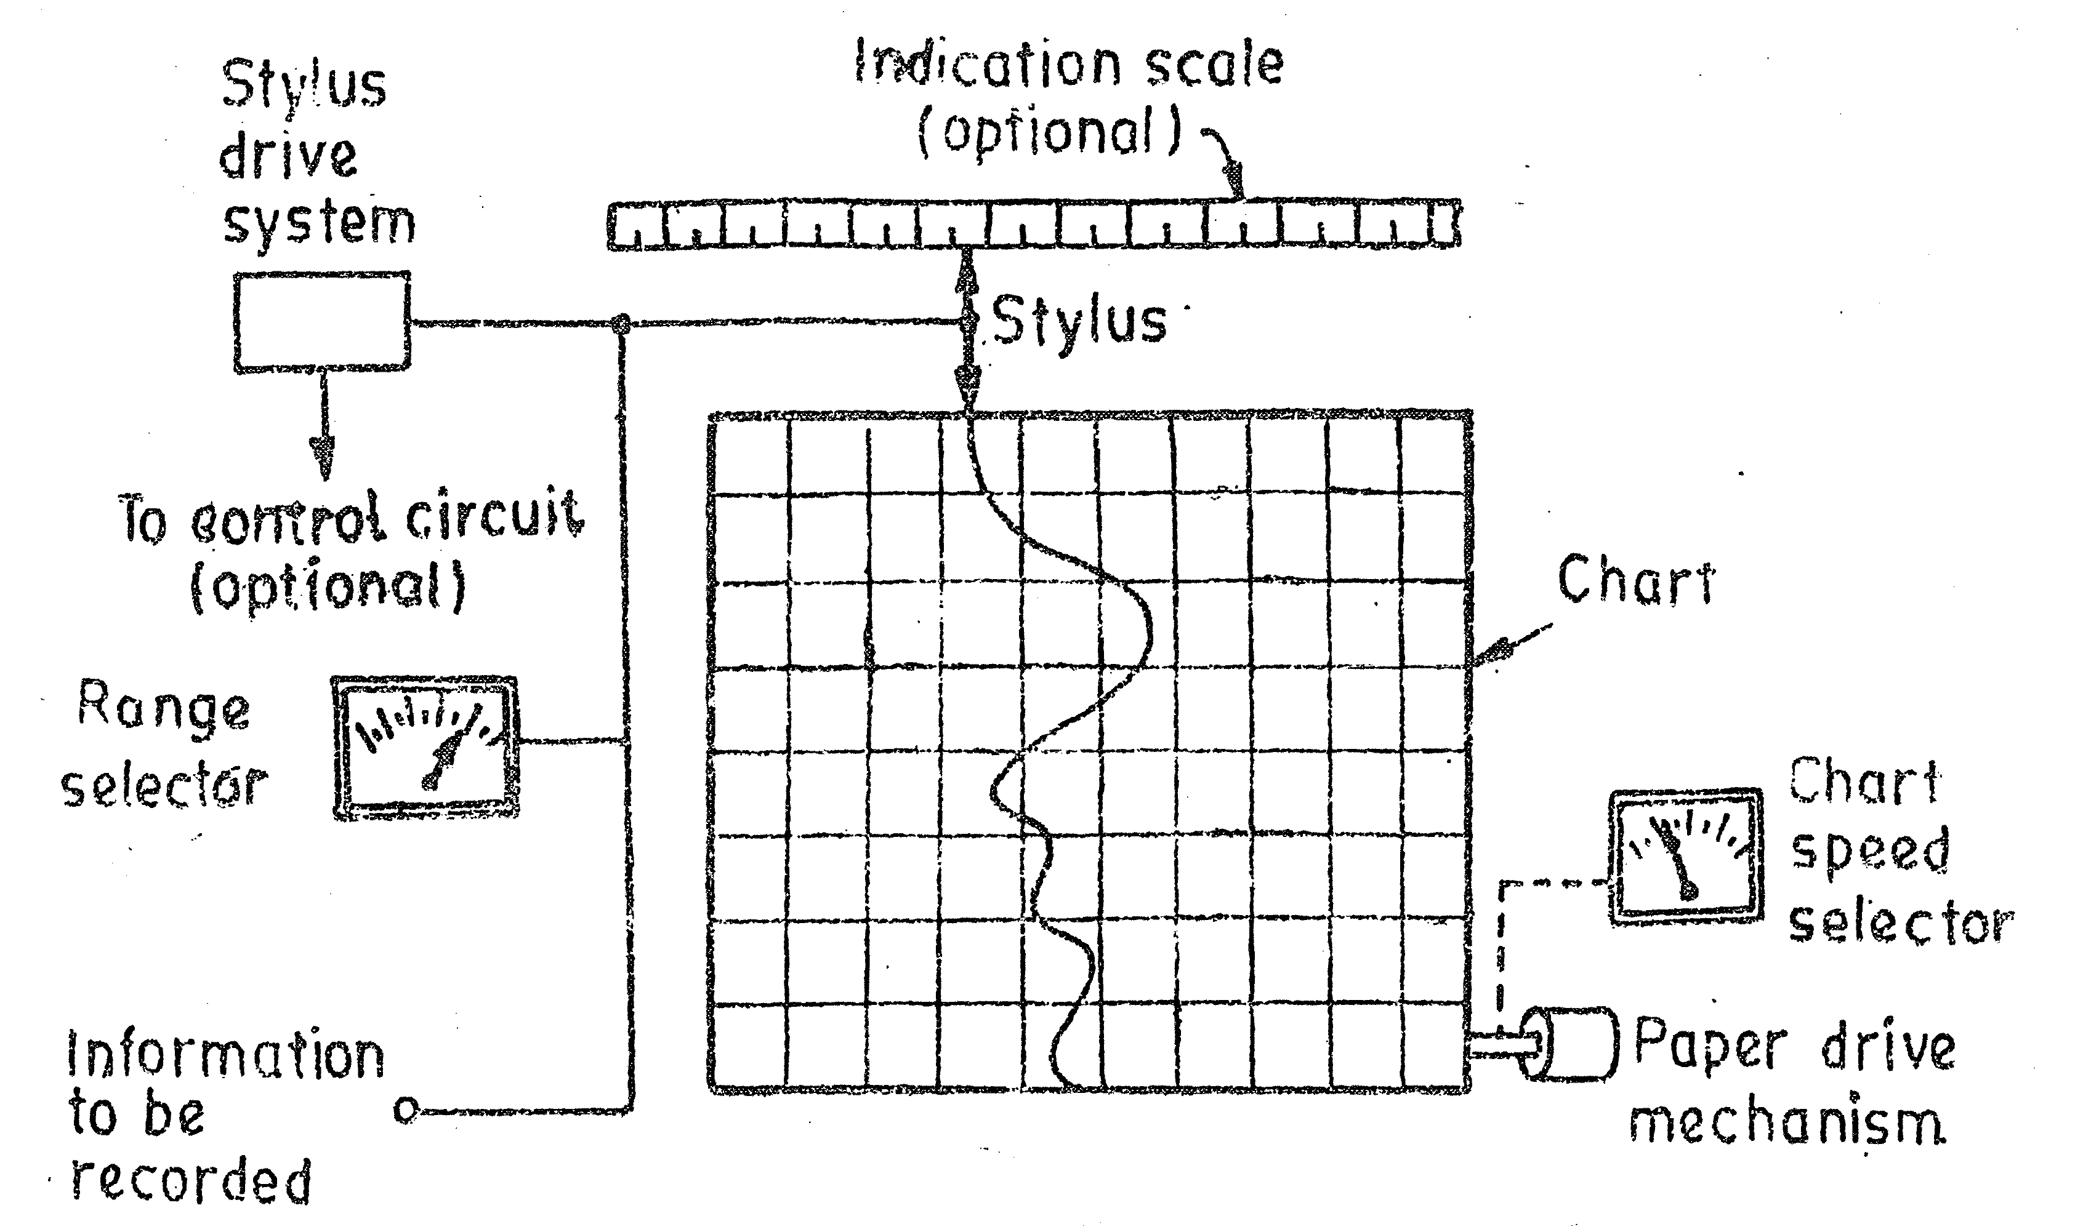
Strip Chart Recorder
  A range selector to fit the input within the acceptable level.
The strip chart recorder is as:

Slide 6
Strip Chart Recorder
Different systems in strip chart recorder:
1.Pen Drive System:
  Consists of long roll of paper moving vertically driven by a synchronous motor equipped with a speed selector.
  2. Tracing System:
  Two types of tracing system to produce graphic representation.
    Curvilinear System
    Rectilinear System

Slide 7
Strip Chart Recorder
3. Marking Mechanism:
  Marking with ink filled stylus
  Marking with heated stylus
  Chopped bar (impart printing)
  Electric stylus marking
  Optical marking
  Electrostatic stylus

Slide 8
X-Y Recorder
X-Y recorders or X-Y plotters accept two inputs and create a chart or graph of one input versus the other.
They are commonly used to determine the relationship between the two inputs.
With the help of these recorders and appropriate transducers, a physical quantity may be plotted against another physical quantity.

Slide 9
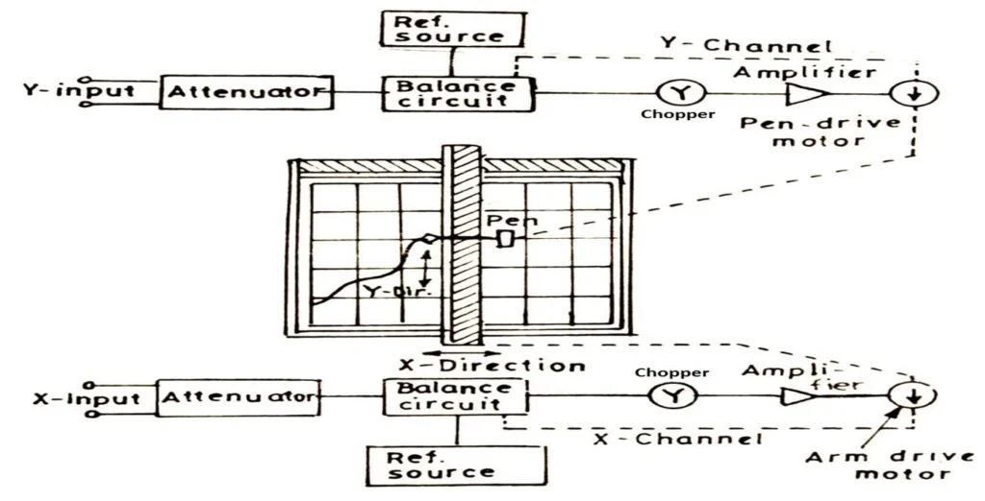
X-Y Recorder

Slide 10
Working of X-Y Recorder
A signal enters in each of the two channels.
Attenuators are used to bring the input signals to the levels (full scale range: 0.5 mV) acceptable by the recorder.
As shown in figure, error signals (the difference between the input signals and reference voltage) are fed to a chopper which convert dc signals to ac signals.
The signals are then amplified in order to actuate servomotors which are used to balance the system and hold it in balance as the value of the quantity being recorded changes.

Slide 11
Working of X-Y Recorder
The action described above takes place in both the axes simultaneously. Thus, we get a record of one variable w.r.t. another.
An X-Y recorder may have a sensitivity of 10 µV/mm, a speed of 1.5 m/s, a frequency response about 6 Hz for both axes, chart size of 250 x 180 mm, and accuracy of about ± 0.3%.

Slide 12
Applications Of X-Y Recorder
Speed-torque characteristics of motors
Plotting of characteristics of vacuum tubes, Zener diodes, rectifiers, transistors etc.
Pressure-volume diagrams for LC engines
Pressure-flow studies for lungs
Lift drag wind tunnel tests
Regulation curve (output versus input voltage) of power supplies
Electrical characteristics of materials such as resistance versus temperature
Plotting stress versus strain curves, hysteresis curves etc.

Slide 13
Magnetic Tape Recorder
The major advantage of using a magnetic tape recorder is that once the data is recorded, it can be replayed an almost indefinite number of times.
The recording period may vary from a few minutes to several days. Speed translation of the data captured can be provided, i.e. fast data can be slowed down and slow data speeded up by using different record and reproduce speeds.
Magnetic tape recorder have a good response to high frequency, i.e. they can be used to record high frequency signals.

Slide 14
Magnetic Tape Recorder
Basic components:
1. Magnetic Tape
2. Recording Head
3. Reproducing Head
4. Tape transport mechanism
5. Conditioning devices

Slide 15
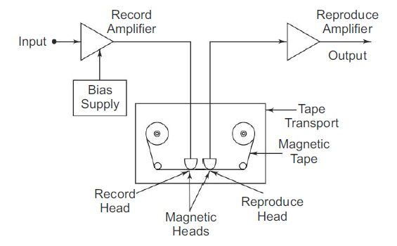
Magnetic Tape Recorder

Slide 16
Magnetic Tape:
  It is made of a thin sheet of tough, dimensionally stable plastic, one side of which is coated with a magnetic material (iron oxide).
Recording Head:
  It is s device that impresses residual pattern upon magnetic tape in response to an amplified i/p signal.
  It consists of core of high permeability material with a coil and fine air gap (10µm).
  The air gap is shunted by passing the magnetic tape and coil current creates flux to bridge the air gap.
  The flux in air gap passes thru the tape and magnetizes iron oxide of the tape.

Slide 17
Reproduce Head:
  Similar to record head.
  Magnetic tape is passed over a reproduce head thereby resulting an o/p voltage proportional to the magnetic flux in the tape across the coil of the reproduce head.
Tape Transport Mechanism:
  It moves the tape along the record head or reproduce head at constant speed without any strain, distortion and tear.
  Tape should be in contact with head.
  Fast winding and rewinding are provided.

Slide 18
Conditioning Device:
  Amplifiers and filters
  Modifies the signal to a format that can be properly recorded on a tape.

Slide 19
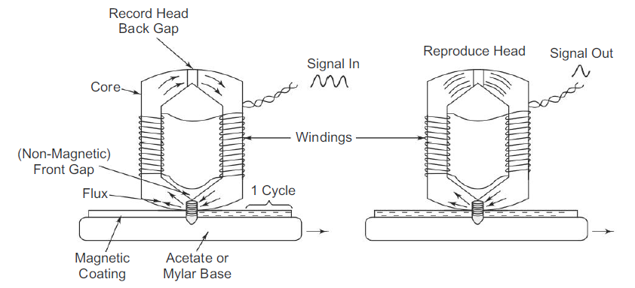
Record and Reproduce Head

Slide 20
Advantages of magnetic tape recorder
They have wide frequency range DC to several MHz.
They have low distortion.
The signal can be reproduced whenever required as magnitude of electrical signal is stored in magnetic memory.
The recorded signal is immediately available. The recorded signal can be played back or reproduced as many times as required without the loss of signal.
The tape can be erased and reused to record a new set of data.

Slide 21
Types of recording
Direct recording
FM recording
Pulse duration modulation (PDM) recording

Slide 22
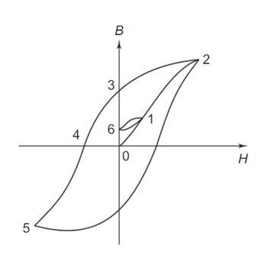
Direct Recording
A simple magnetic particle on the tape might have the B – H curve below where H is the magnetising force and B the flux density in the particle.
Consider the material with
no flux at all, i.e. the condition
at point 0.

Slide 23
Direct Recording
If the current in the coil of the recording head increased from 0 in a direction that gives positive values of H, the flux density increases along the path 0 – 1– 2, until the material is eventually saturated.
If the operating point is brought from 0 only as far as 1, and H is brought back to 0, B follows a minor hysteresis loop back to point 6.
A greater value of coil current would leave a higher residual fl ux, and a lower current a lower residual; a very simple recording process results.

Slide 24
Direct Recording
The linearity between residual flux and recording current is very poor.
Hence, to obtain linearity in direct recording, FM is used (i.e. a high frequency ac is added).
In all systems, the signal is reproduced by passing the magnetised tape over a magnetic head similar to the recording head.
The magnetisation of the particles on the tape induces a varying flux in the reproducing head and a voltage is induced in the coil, proportional to the rate of change of flux.

Slide 25
During reproduction:
The tape is passed over a reproducing head resulting in an o/p voltage proportional to the magnetic flux in the tape, across the coil of reproducing head.
Since the o/p voltage depends on the rate of change of flux . Id dc at i/p had produced constant tape magnetization, the reproducing head would have given zero o/p voltage. So, the direct recording process can be used with varying i/p signal with about 50Hz.
Since the reproduce head has differentiating characteristics, the reproducing amplifier must have an integrating characteristics so that the system o/p is proportional to i/p.

Slide 26
Merits of Direct Recording
This recording process has a wide frequency response, ranging from 50 Hz – 2 MHz for a tape speed of 3.05 m/s. It provides the greatest
bandwidth obtainable for a given recorder.
It requires simple electronic circuits.
It has a good dynamic response and takes overloads without increase in distortion.
It is used to record signals where information is contained in the relation between frequency and amplitude, such as the spectrum analysis of noise.
It can be used for recording voice signals.

Slide 27
Demerits of Direct Recording
The direct recording process is characterised by some amplitude instability caused by random surface inhomogeneiti coating. Some portion may not be perfectly recorded owing to dirt or poor manufacture.
This recorder is only used when maximum bandwidth is required.

Slide 28
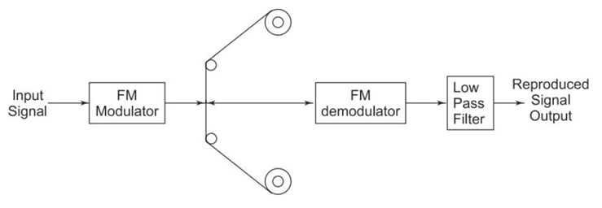
FM Recording
In FM recording system, a carrier oscillator frequency fc, called the centre frequency, is modulated by the level of the input signal.

Slide 29
FM Recording
When there is no input signal, i.e. zero input, the modulation is at centre frequency fc.
If a positive input signal is applied, the frequency deviates from the centre frequency by some amount in a certain direction; the application of a negative input voltage deviates the carrier frequency in the opposite direction.
The output of the modulation, which is fed to the tape, is a signal of constant frequency for dc inputs, and varying frequency for ac inputs. The variation of frequency is directly proportional to the amplitude of the input signal.

Slide 30
FM Recording
On playback, the output of the reproduce head is demodulated and fed through
a low pass filter which removes the carrier and other unwanted frequencies reproduced due to the modulation process.
The operation of FM modulation can be easily checked by applying a known input voltage and measuring the output frequency with an electronic counter.
This signal is applied to the tape with no further conditioning, as the signal is independent of the amplitude.
The FM demodulator converts the difference between the centre frequency and the frequency on the tape, to a voltage proportional to the difference in the frequencies.
This system can thus record frequencies from dc to several thousand Hertz.
Residual carrier signals and out of band noise are removed by a low pass filter.

Slide 31
Merits of FM Recording
FM recording is useful primarily when the dc component of the input signal is to be preserved.
This system has a wide frequency range and can record from dc voltages to several kHz.
There is no drop-out effect due to inhomogeneties of the tape material.
Independent of amplitude variations, and accurately reproduces the waveform of the input signal.
Used extensively for recording voltages derived from non-electrical quantities, such as force, acceleration and pressure.
It is extremely useful for multiplexing in an instrumentation system.

Slide 32
Demerits of FM Recording
FM recording is extremely sensitive to tape speed fluctuations.
FM recording circuitry is more complicated than that of direct recording systems.
FM system has a limited frequency response.
It requires a high tape speed.
It requires a high quality of tape transport and speed control.

